Slide 1
Spiritualism & the Civil War
Dr. Joshua Paddison, Texas State University

Slide 2
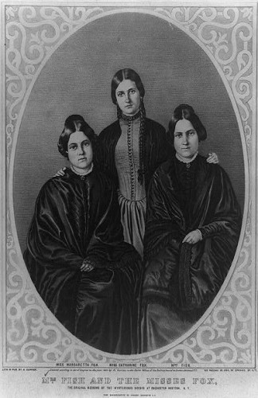
Fox Sisters in 1852: Leah, Kate & Maggie

Slide 3
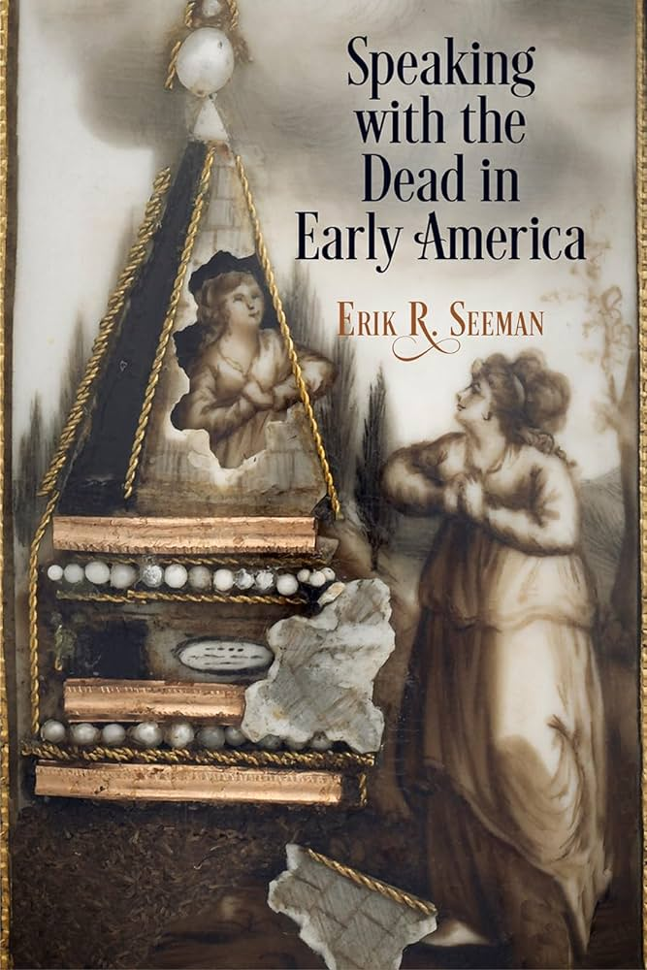
Erik R. Seeman’s Speaking with the Dead in Early America

Slide 4
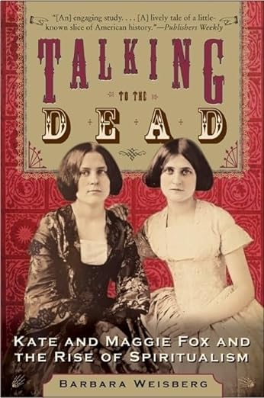
Barbara Weisberg’s Talking to the Dead

Slide 5
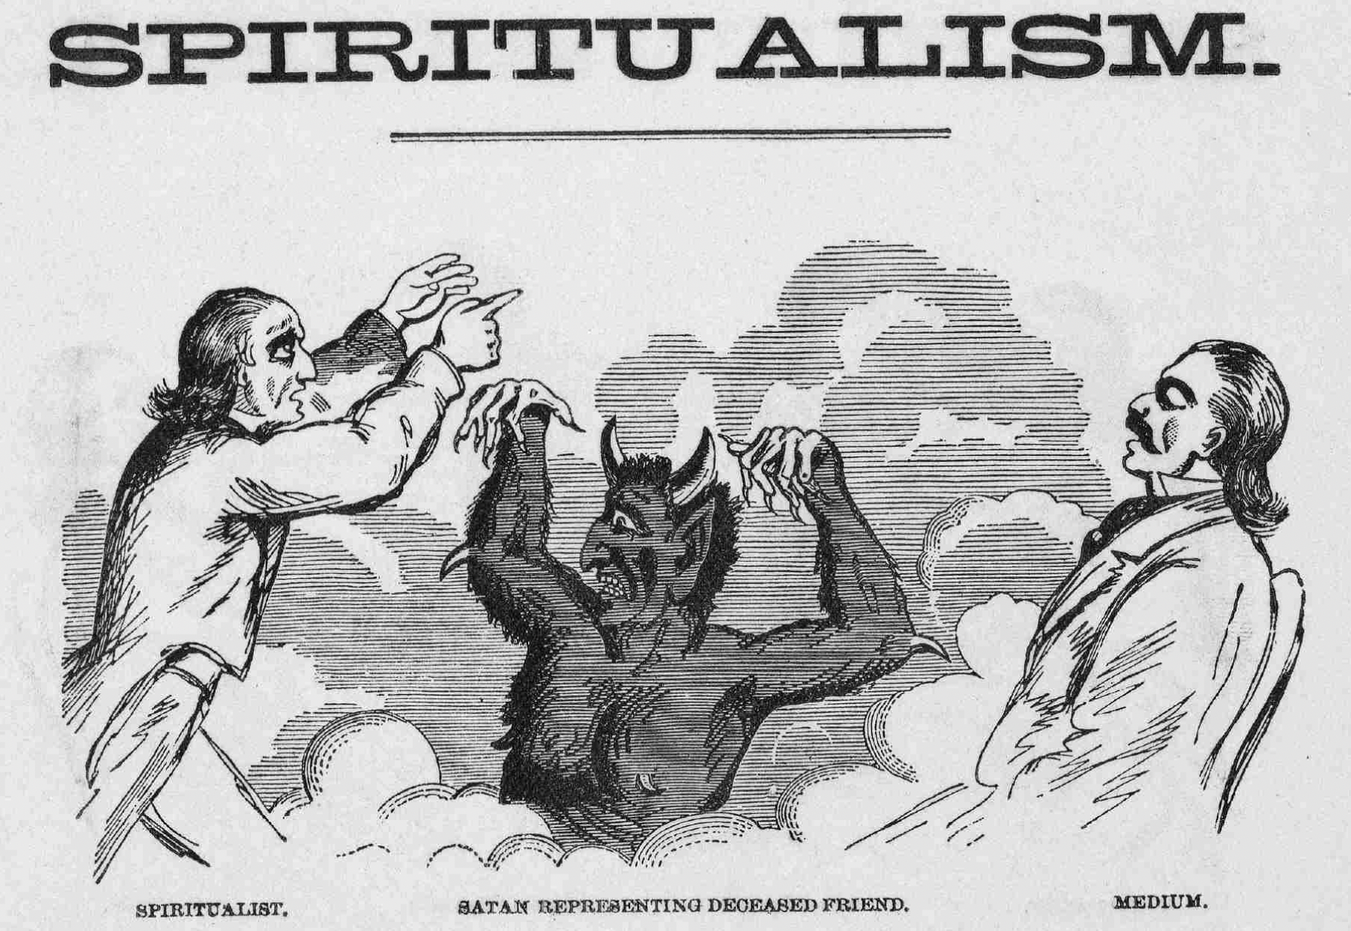
Anti-spiritualist broadsheet, 1865

Slide 6
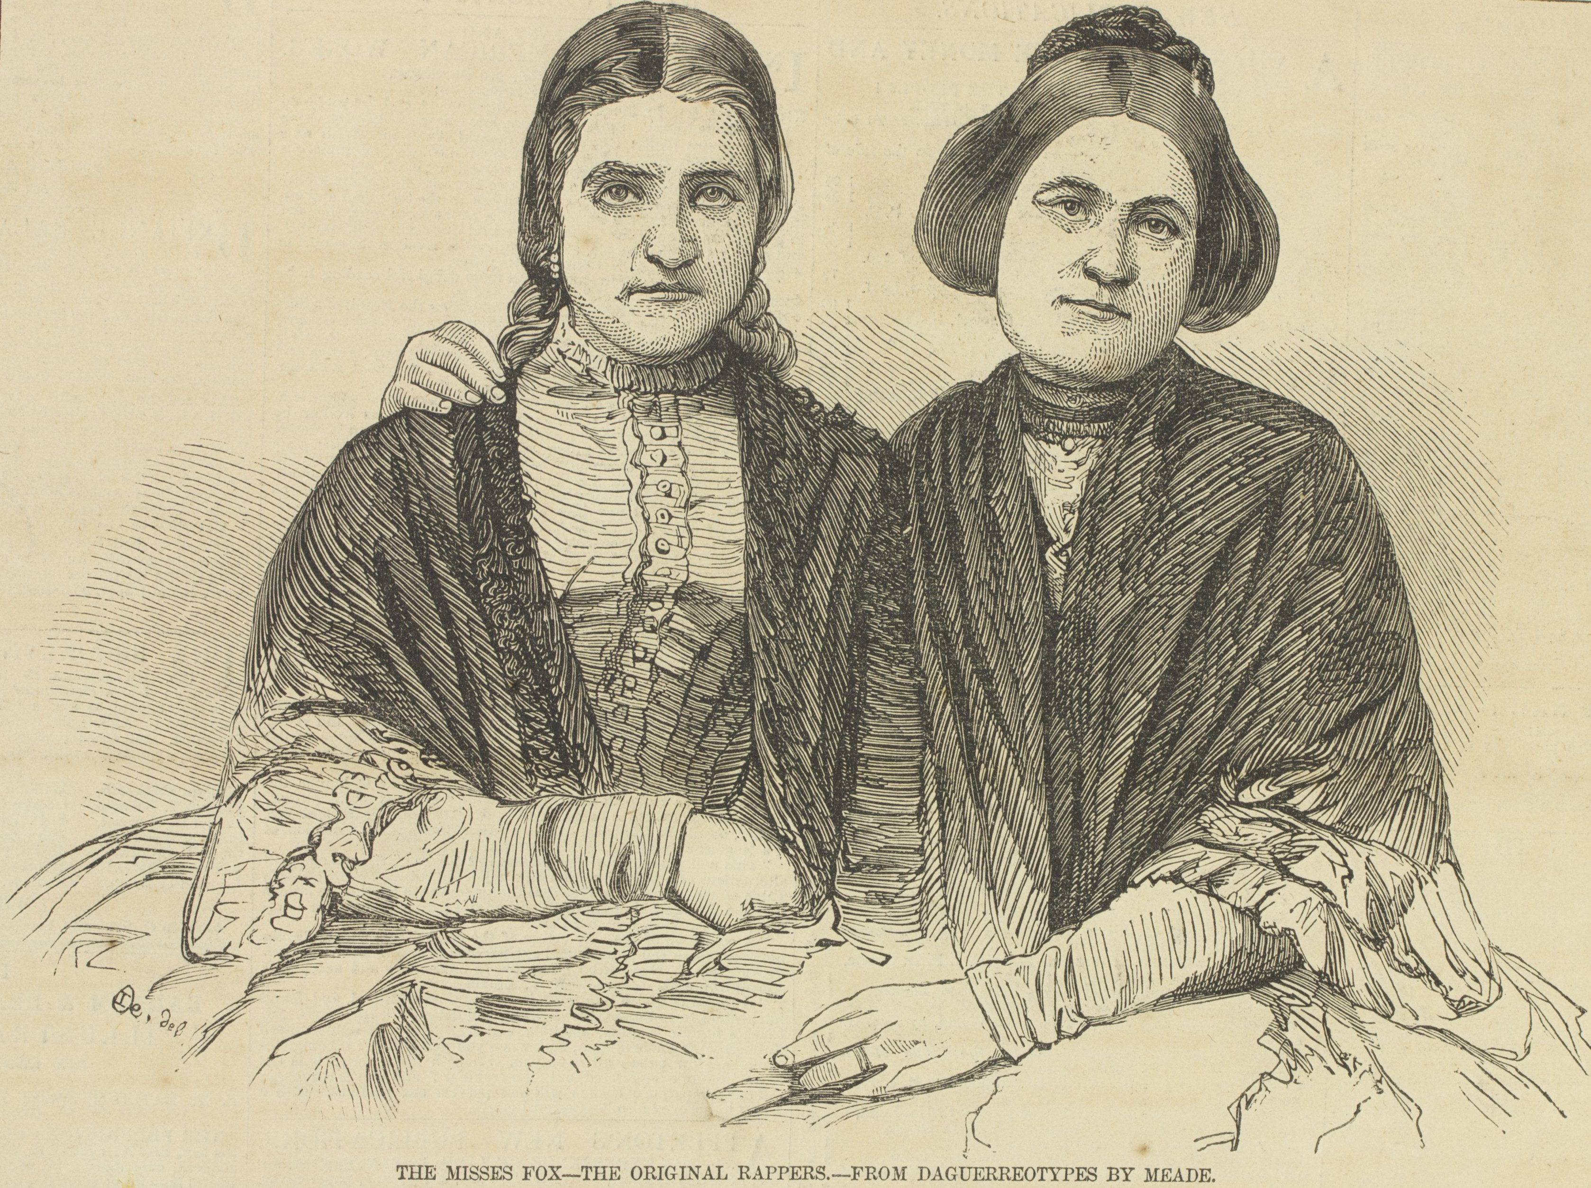
Kate and Maggie Fox in 1853

Slide 7
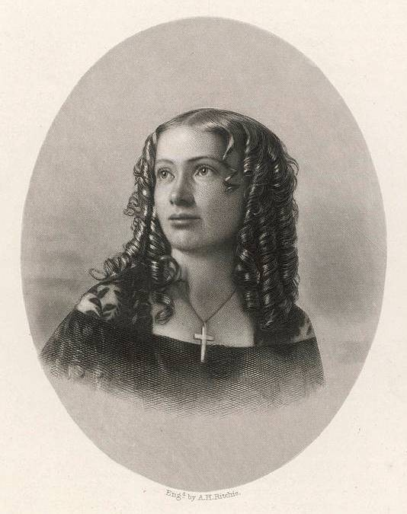
Cora Scott, 1857

Slide 8
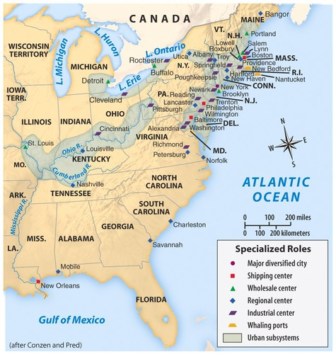
U.S. cities, 1840

Slide 9
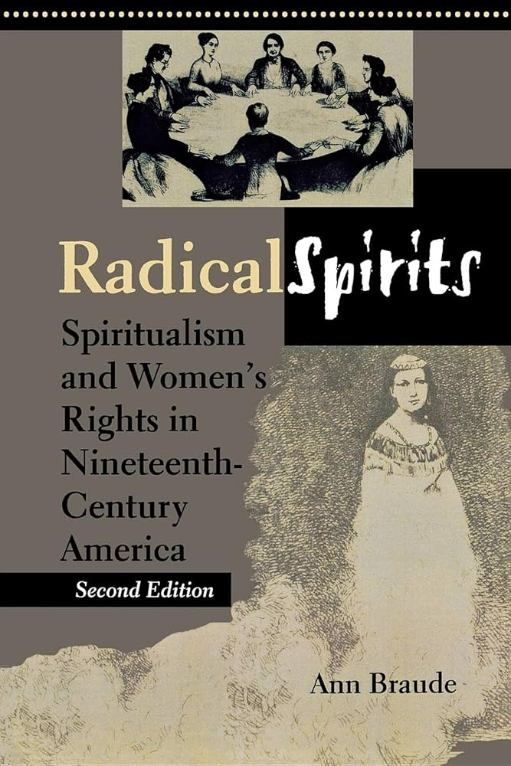
Ann Braude’s Radical Spirits

Slide 10
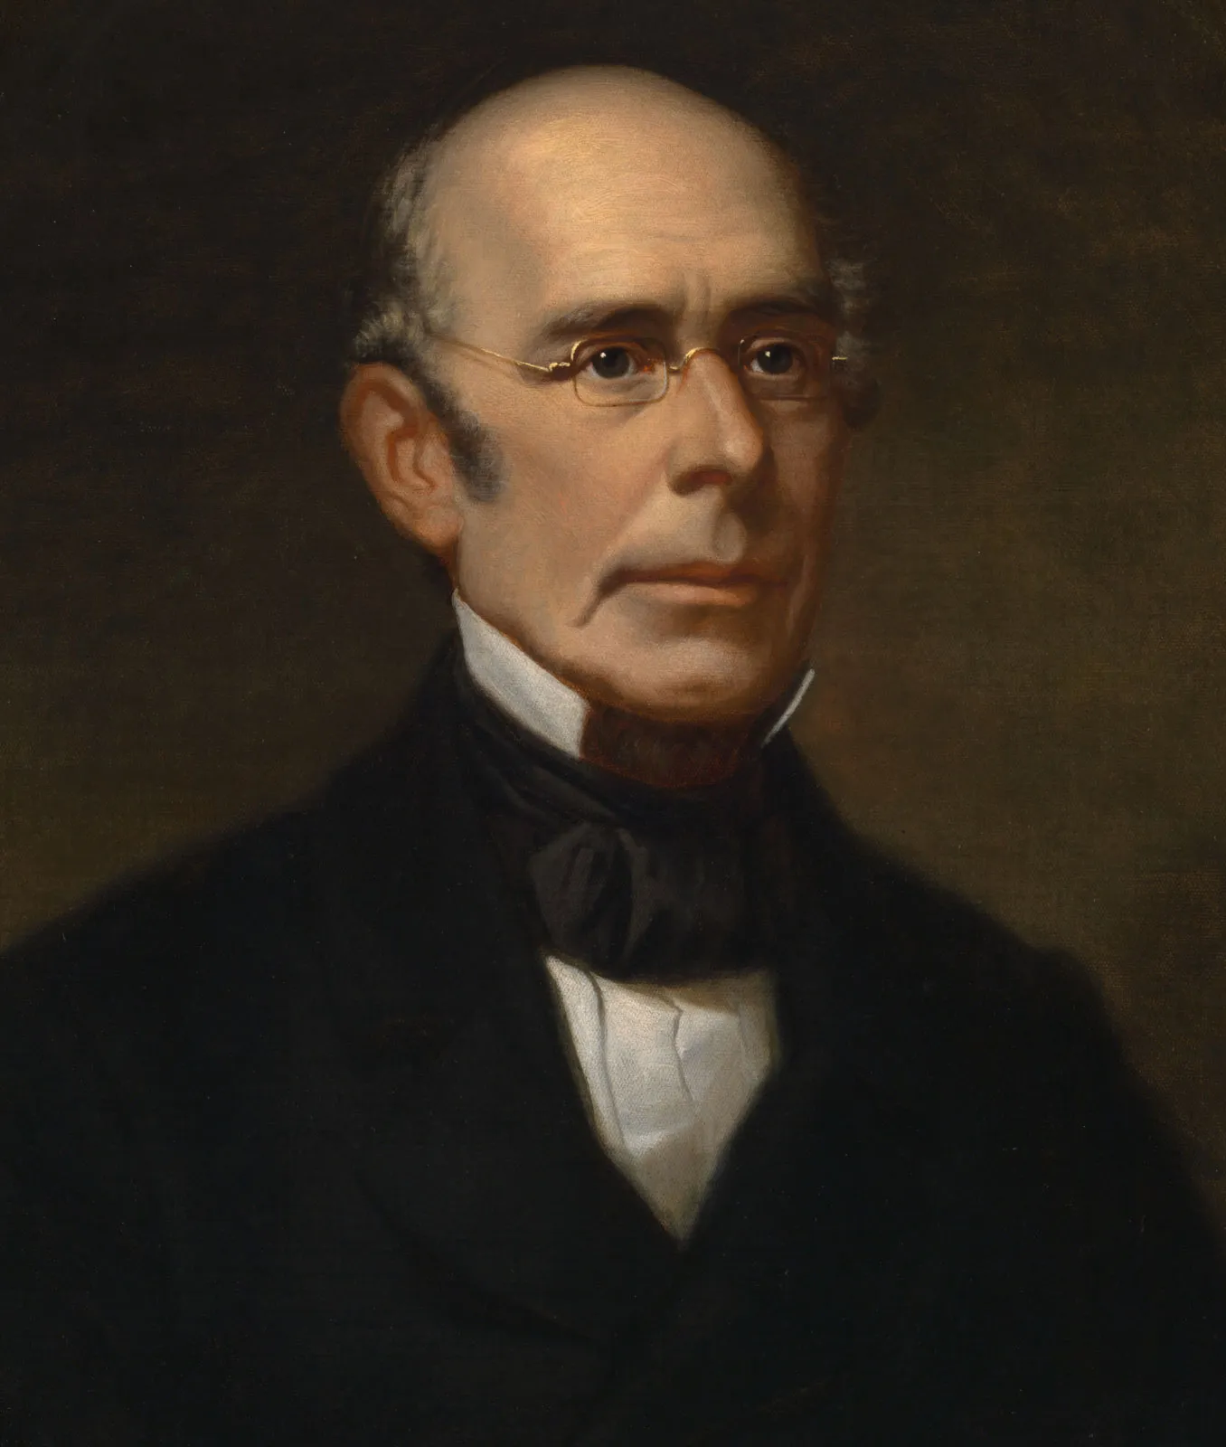
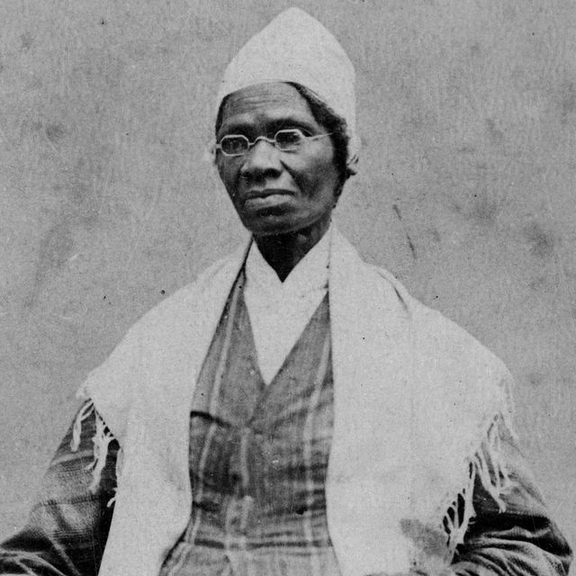
William Lloyd Garrison and Sojourner Truth

Slide 11
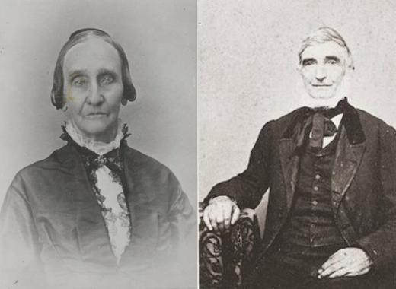
Amy and Isaac Post

Slide 12
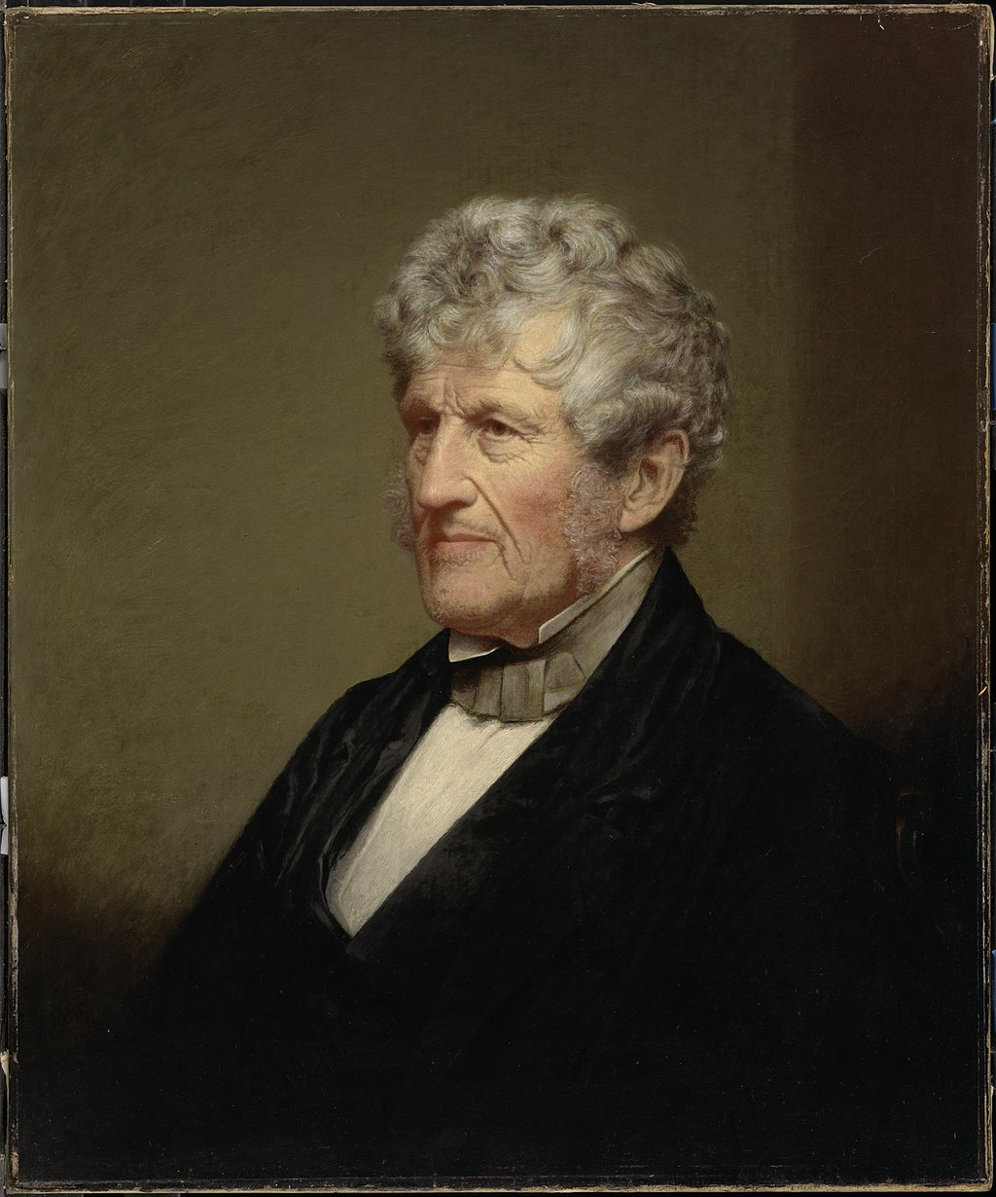
Robert Hare

Slide 13
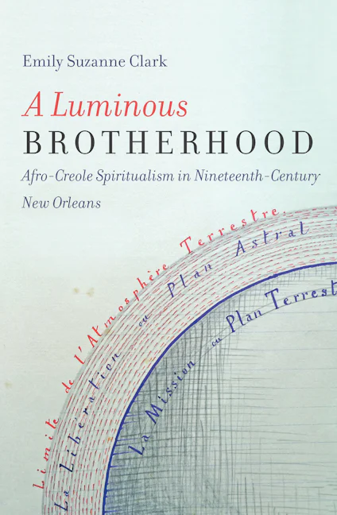
Emily Clark’s A Luminous Brotherhood

Slide 14
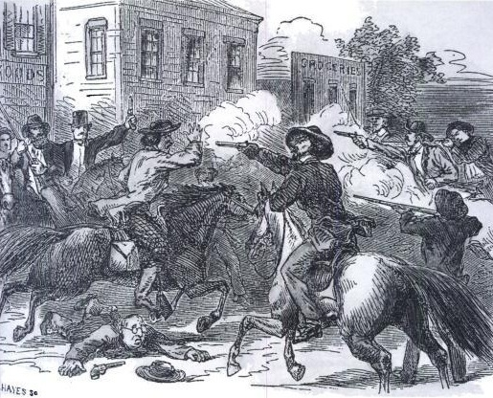
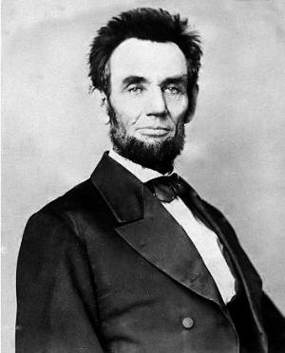
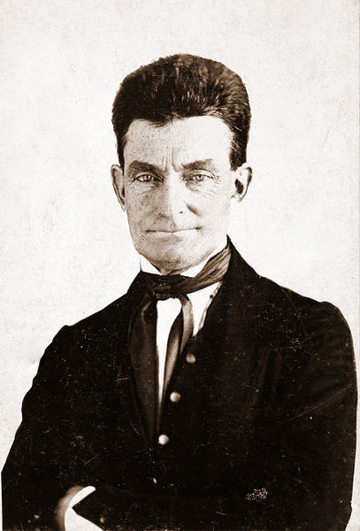
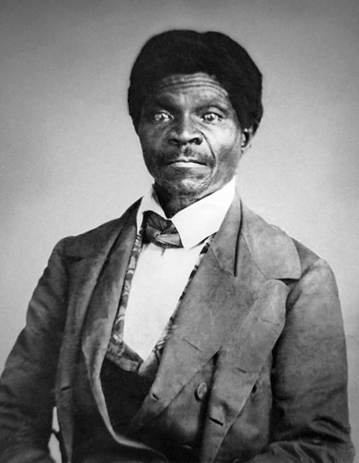
Bleeding Kansas, 1855-1861
Dred Scott decision, 1857
Lincoln and Republican Party, 1850s
John Brown’s raid, 1859

Slide 15
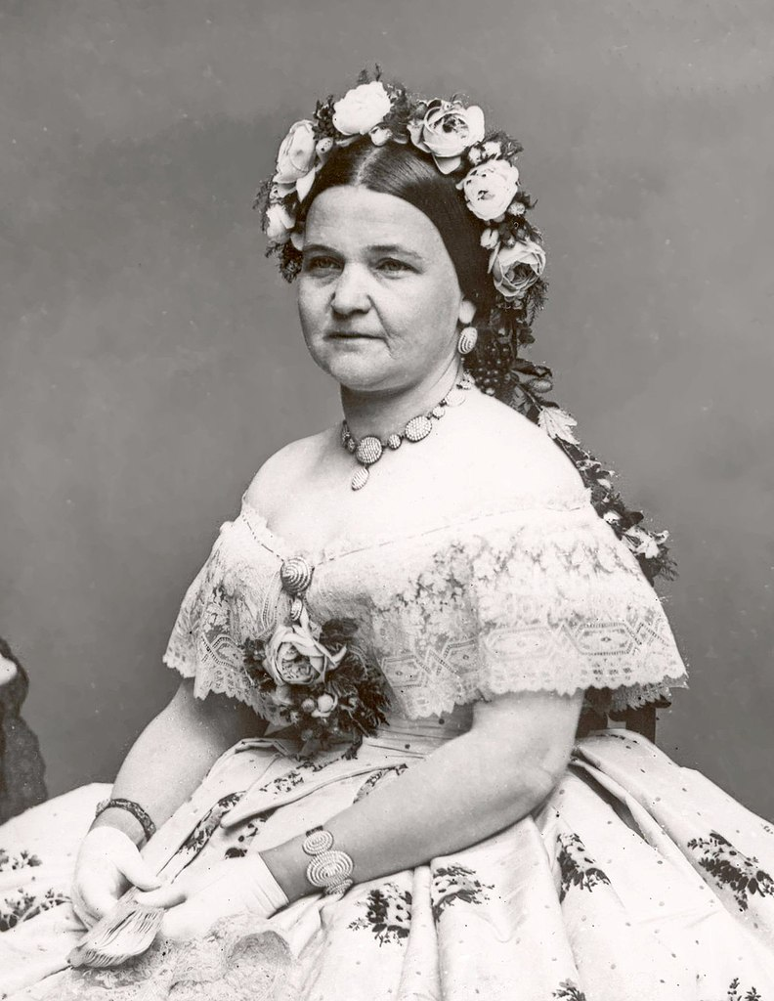
Mary Todd Lincoln

Slide 16
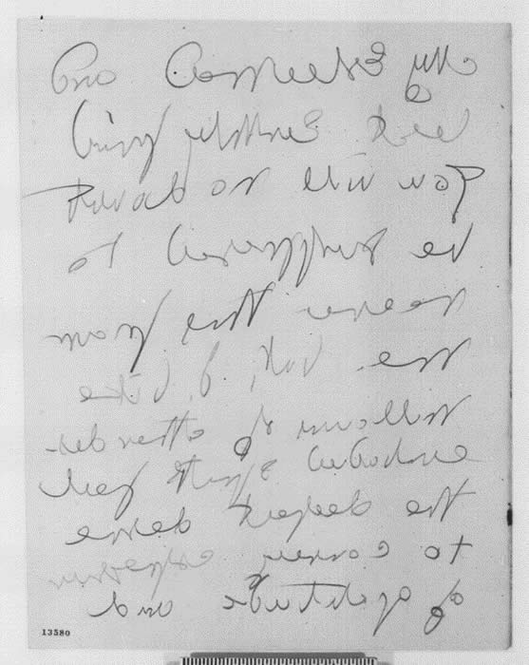
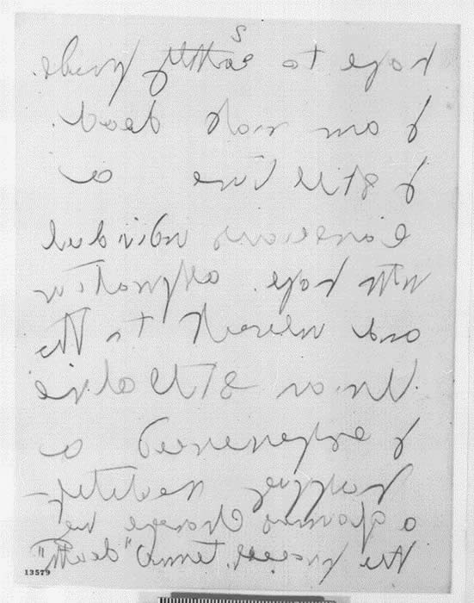
J. B. Conklin’s letter to Lincoln, 1862

Slide 17
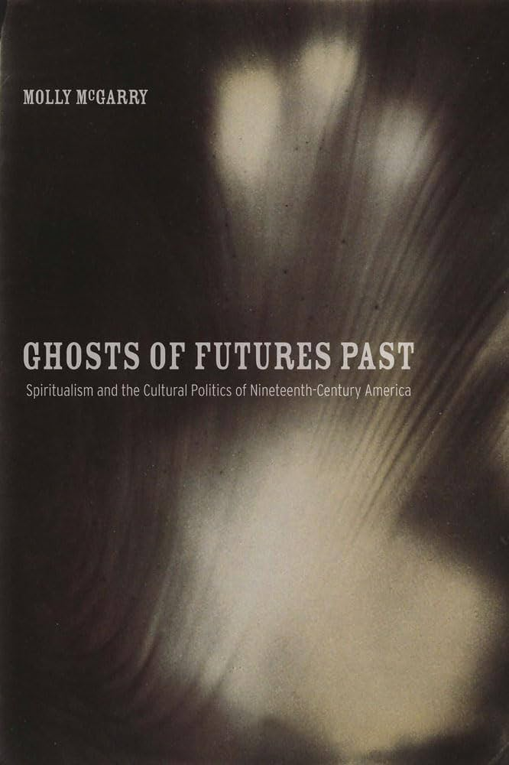
Molly McGarry’s Ghosts of Futures Past

Slide 18
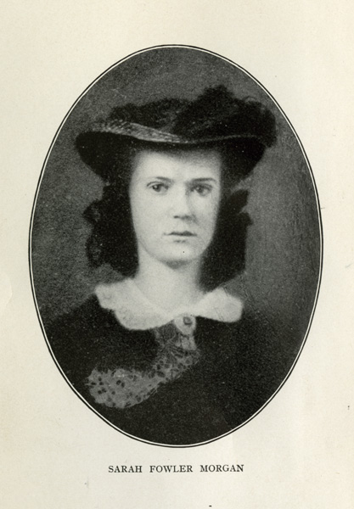
Sarah Morgan

Slide 19
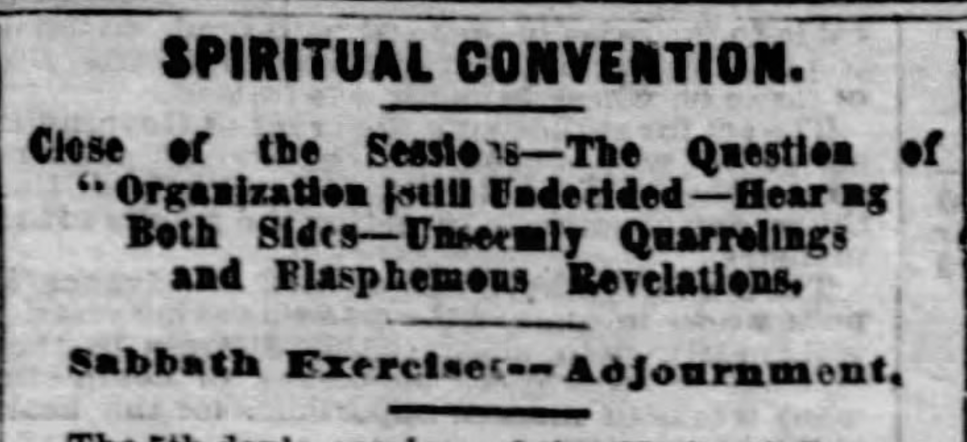
National Spiritualist Convention, 1864

Slide 20
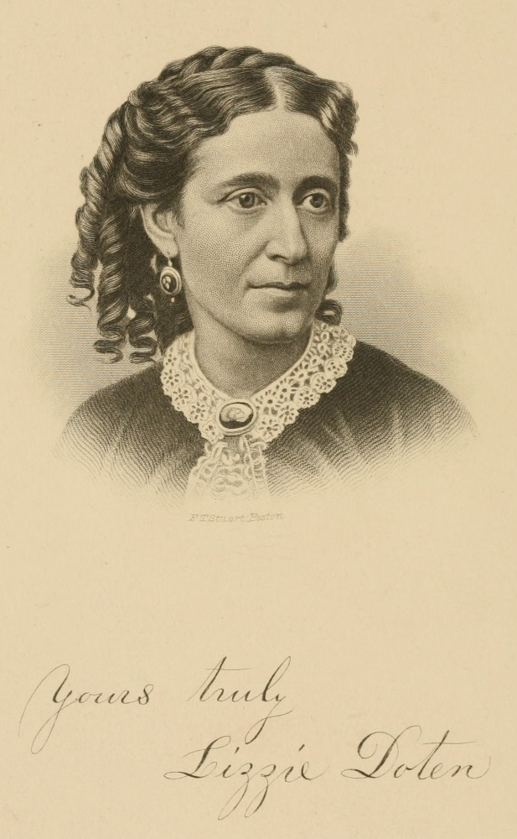
Lizzie Doten

Slide 21
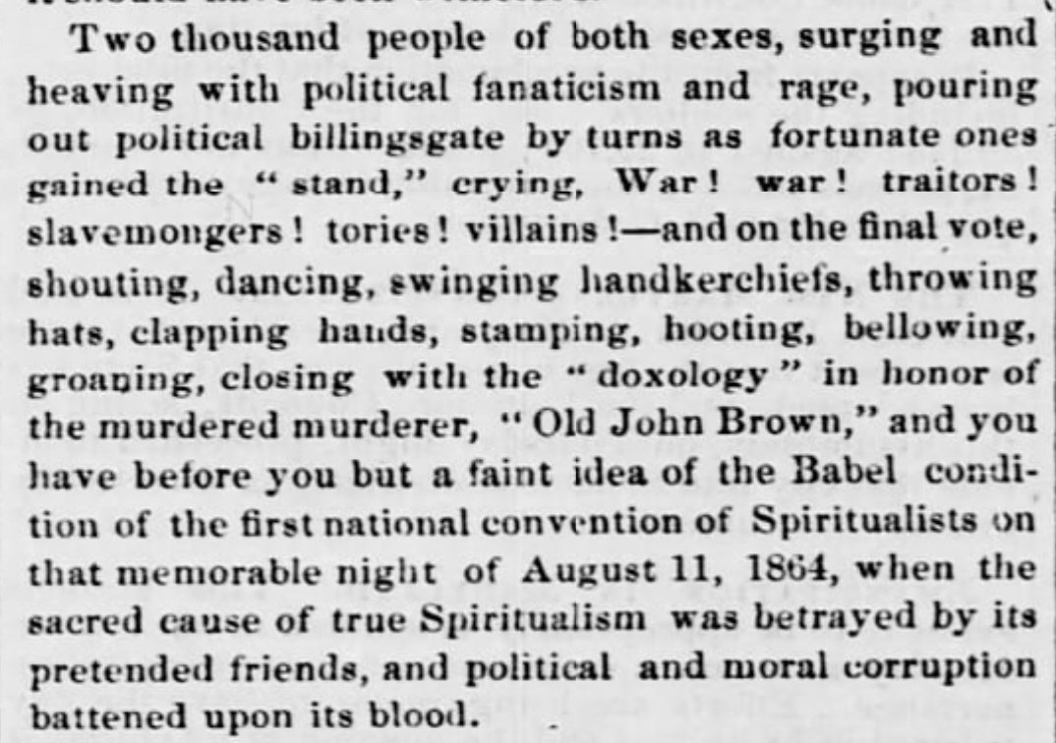
Liberator, November 4, 1864

Slide 22
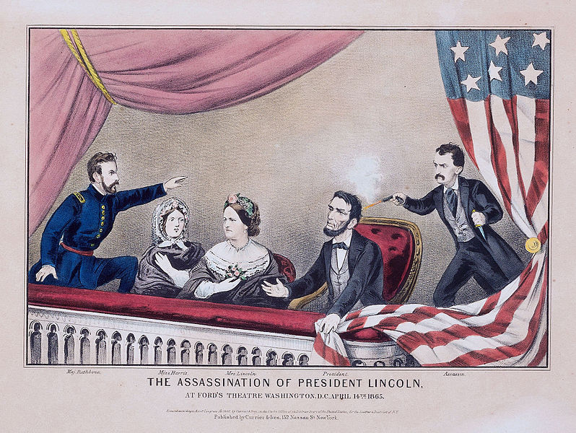

Slide 23
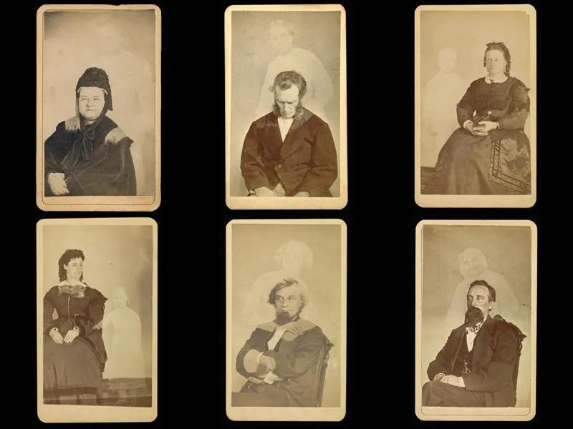
William Mumler’s spirit photography

Slide 24
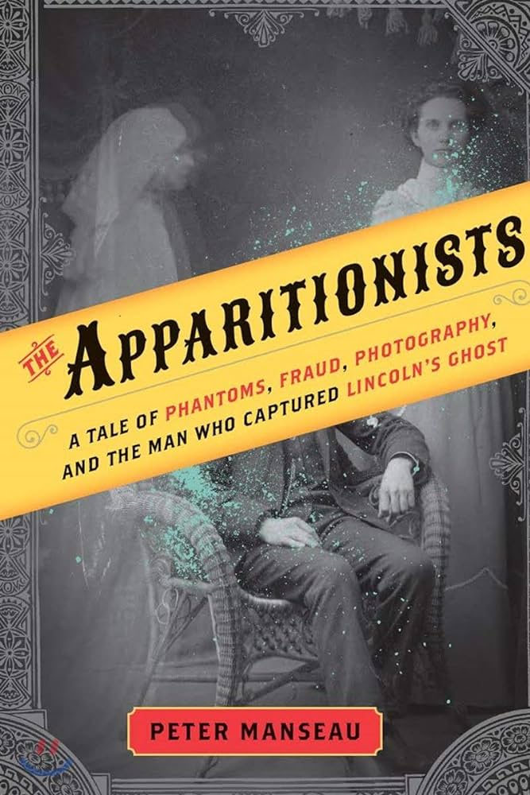
Peter Manseau’s The Apparitionists

Slide 25
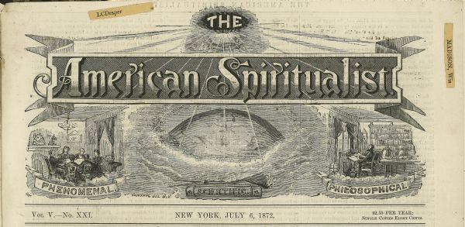
Spiritualist periodicals

Slide 26
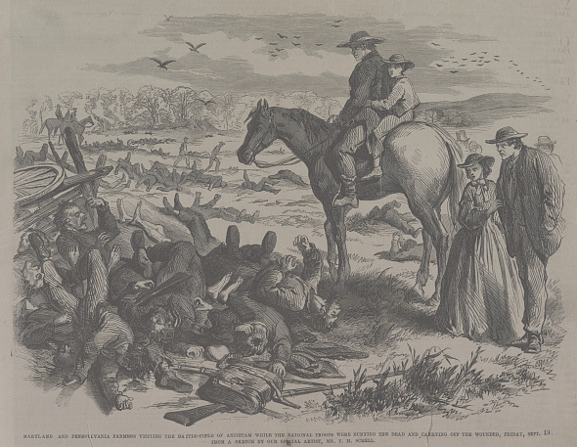
Frank Leslie’s Illustrated Newspaper, 1862

Slide 27
Spiritualism & the Civil War
Dr. Joshua Paddison, Texas State University

